Slide 1
Simulated Multiple Reference Training (SMRT)
Improves Low-Resource Machine Translation
Huda Khayrallah, Brian Thompson,
Matt Post & Philipp Koehn
huda@jhu.edu

Slide 2
use target side paraphrasing
to overcome data sparsity
in low-resource settings

Slide 3
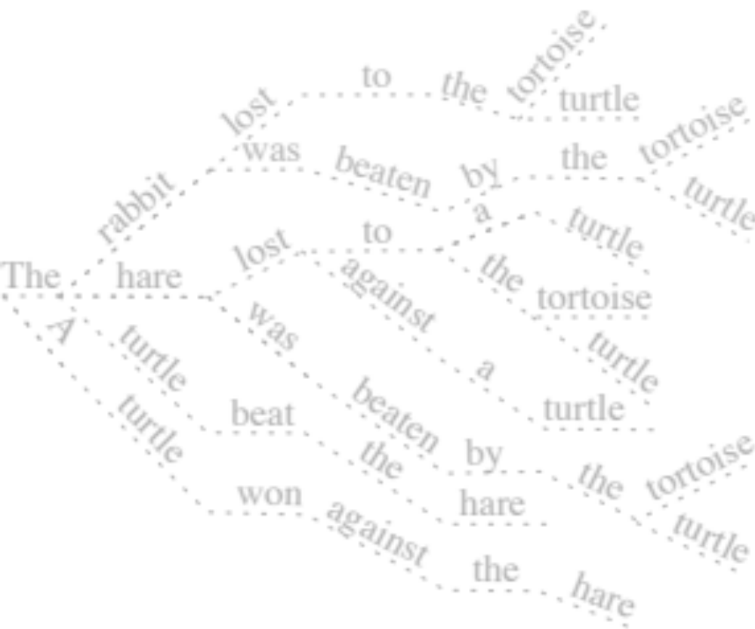
La tortuga ganó contra la liebre | The turtle beat the hare
3

Slide 4
Machine Translation
NMT
La tortuga ganó contra la liebre
4

Slide 5
Machine Translation
The
NMT
La tortuga ganó contra la liebre
5

Slide 6
Machine Translation
The
NMT
La tortuga ganó contra la liebre
6

Slide 7
Machine Translation
The
the
turtle
beat
hare
NMT
La tortuga ganó contra la liebre
7
Notes:
And that will be used for subsequent word predictions
Trained end-to-end on parallel text, loss comes from one word prediction at a time
Data hungry --- ideally trained on millions of parallel sentences

Slide 8
La tortuga ganó contra la liebre | The turtle beat the hare
8

Slide 9
La tortuga ganó contra la liebre | The turtle beat the hare
The
the
turtle
beat
hare
9

Slide 10
NLL Objective
Gold Target
MT Model output
Cross Entropy( , )
Cross Entropy( , )
Gold Target
MT Model
output
10

Slide 11
La tortuga ganó contra la liebre | The turtle beat the hare

Slide 12
Paraphraser
A
the
turtle
against
won
hare
Paraphraser
The turtle beat the hare
12

Slide 13
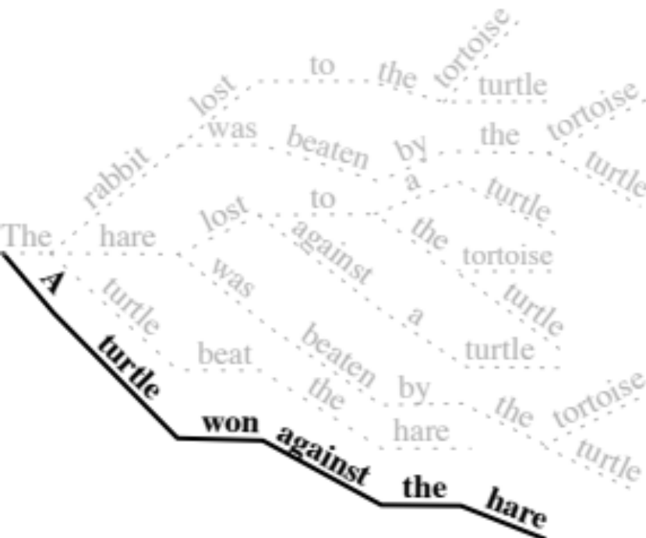
Paraphraser
A
the
turtle
against
won
hare
Paraphraser
The turtle beat the hare
13

Slide 14
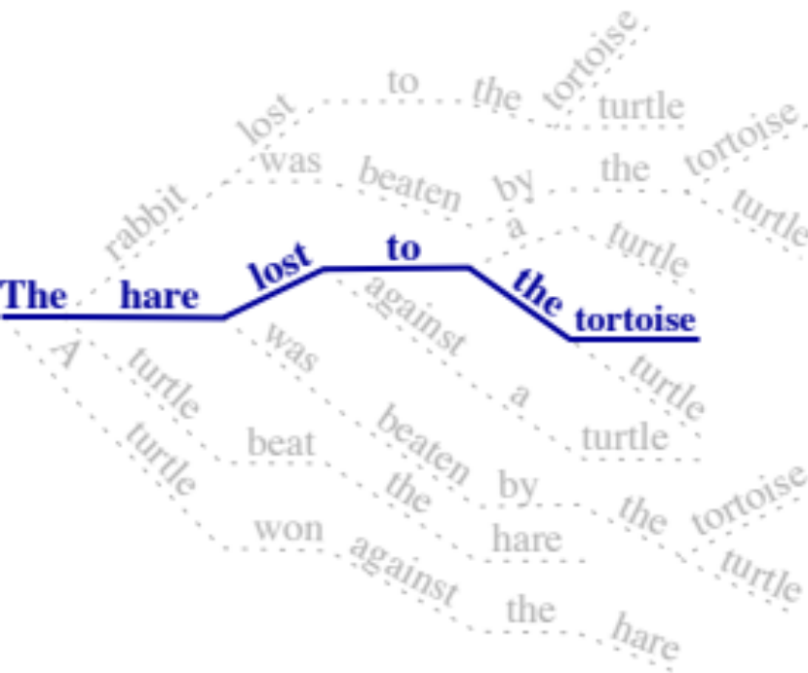
Sampling
to
The
the
lost
tortoise
rabbit
Paraphraser
The turtle beat the hare
14

Slide 15
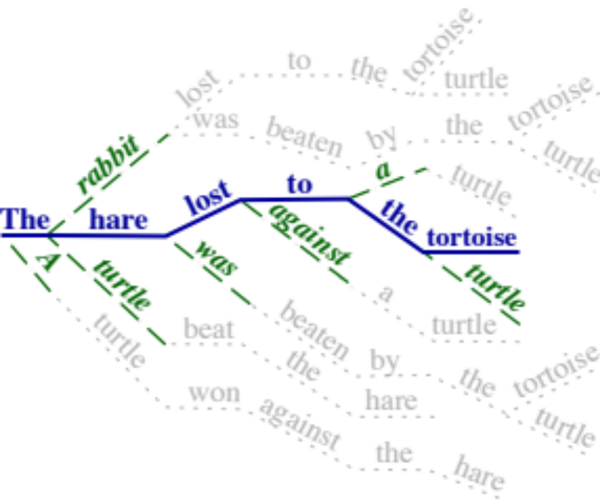
Distribution
to
The
the
lost
tortoise
rabbit
Paraphraser
The turtle beat the hare
15

Slide 16
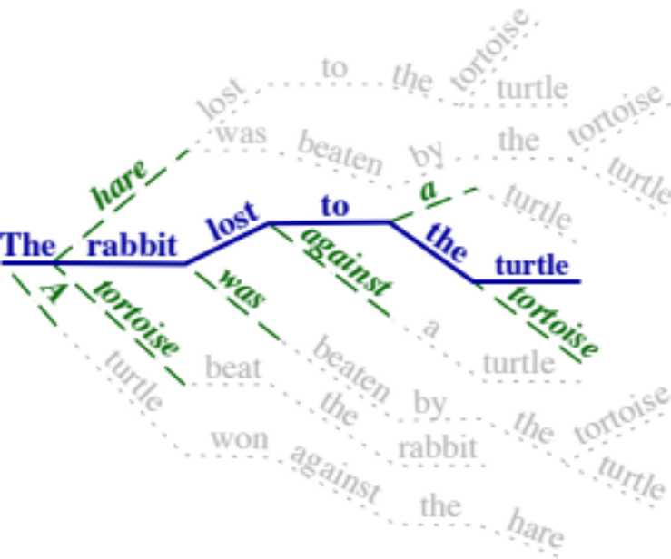
SMRT Objective
Paraphraser Output
MT Model output
Cross Entropy( , )
Paraphraser Output
MT Model
output
16

Slide 17
SMRT Objective
Paraphraser Output
(teacher)
MT Model output
(student)
Cross Entropy( , )
Paraphraser Output
(teacher)
MT Model
Output
(student)
17

Slide 18
SMRT Objective
Paraphraser Output
MT Model output
Gold Target
MT Model output
18

Slide 19
Experimental Details
transformer model in fairseq (Ott et al., 2019)
Global Voices corpora (Tiedemann, 2012)
  (+ MATERIAL corpora in paper)
Use SMRT w/ 50% probability, NLL otherwise
English Paraphraser trained on ParaBank2 (Hu et al., 2019)
4k SentencePiece vocab (Kudo & Richardson 2018)
Code, Global Voices Data splits & paraphraser released: data.statmt.org/SMRT
19

Slide 20
Results

Slide 21
Results

Slide 22
Results

Slide 23
But wait, there’s more! (in the paper)
Comparison to back-translation
  Both work, SMRT is better than BT in very low resource
  Can combine for larger improvement
Data ablation
  Larger improvements in lower resource settings
Method ablation
  Both sampling and the distribution in the loss are helpful
Sequence-Level Paraphrastic Augmentation
  It works; SMRT is better
23

Slide 24
But wait, there’s more! (other papers)
Thompson & Post have a new multilingual paraphraser (Prism) that works for 39 languages and is a great
MT metric (@EMNLP)
Khayrallah & Sedoc apply SMRT + Prism to Chatbots (@EMNLP findings)
This work will be published @EMNLP
24

Slide 25
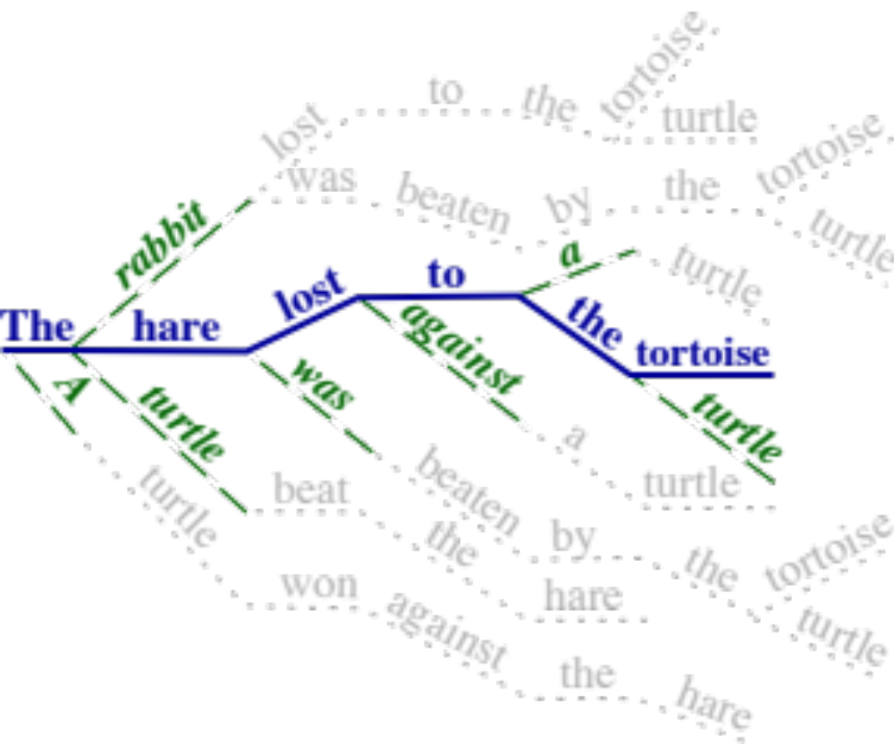
Summary
Questions? Hiring?
Huda Khayrallah
huda@jhu.edu
Code, Global Voices Data splits & paraphraser released: data.statmt.org/smrt

