Slide 1


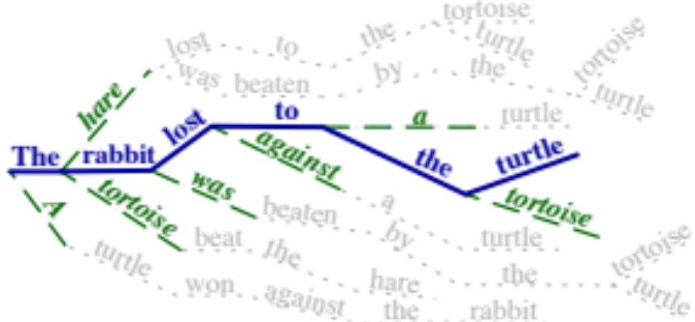
Simulated Multiple Reference Training Improves Low-Resource Machine Translation
Huda Khayrallah, Brian Thompson, Matt Post & Philipp Koehn | Johns Hopkins University
use a target language paraphraser
in the training objective
to overcome data sparsity
in low-resource settings
Questions? Hiring?
huda@jhu.edu
src: La tortuga ganó contra la liebre
ref: The turtle beat the hare
NLL
Gold Target
MT Model output distribution
SMRT
Paraphraser output distribution
MT Model output distribution
Transformer models in fairseq (Ott et al., 2019)
Global Voices corpora (Tiedemann, 2012)
Translating to English
English Paraphraser trained on ParaBank2 (Hu et al., 19)
Use SMRT w/ 50% probability, NLL otherwise
4k SentencePiece vocab (Kudo & Richardson 2018)
Code, Paper & more: data.statmt.org/smrt

